Slide 1
Assessment 1 – Planning
PROM02: Computing Master’s Project
Dr Becky Allen
Becky.allen@sunderland.ac.uk

Slide 2

Objectives
In this session we will cover:
What is the planning review?
How does it relate to the project proposal?
What does it consist of?
How to complete the project schedule
Completing the evaluation plan
What is SEPLi?

Slide 3
Overview
Assessment 1 – Planning is worth 10%
Planning Review Submission Marks
Section 1 : Terms of Reference – 50%
Section 2: Project Schedule – 20%
Section 3 : Evaluation Plan – 10%
Section 4 : SEPLi – 20%
Social, Ethical Professional and Legal issues
Each section has an assigned word limit

Slide 4
Section 1: Terms of Reference – (50%)
1.1 Project Title
Clear and understandable
Describes the project
Look at the title of research papers for inspiration
1.2 Project Overview
Aim/s
What do you intend to do / achieve overall in your project.
Must incorporate research and practice.

Slide 5
Section 1: Terms of Reference – (50%)
1.2 Project Overview continued
Objectives
Between 5 – 8 bulletpoints
SMART (Specific, Measurable, Achievable, Realistic, Time-Bound)
Identify what you want to achieve and the related deliverables
Objectives should be linked to the aim/s and your research question
You will be evaluating your overall project against these objectives
Research Question
Must be a question and must be answerable through:
Proposed literature focus
Practical work
Exploration / activities you undertake in your project

Slide 6

Example Research Questions
What are the perceived risks of cloud-based storage systems?
What are the effects of VR and AR integration within the Computer Science classroom?
Which AI techniques are currently used in breast cancer detection and can they improve diagnostic accuracy?

Slide 7
Section 1: Terms of Reference (50%)
1.2 Project Overview continued
Practical Outcome
Up to 5 bullet points detailing your practical outputs or key deliverables
For example: If your main practical outcome is creating software you may have the following outcomes:
Requirements Analysis
A range of design specification documents
An initial prototype
Testing documentation
Refined prototype

Slide 8

Section 1: Terms of Reference (50%)
1.3 Literature Review
Annotated bibliography of 10 high quality research papers you have read that are relevant to your project.
Correct citation – Harvard referencing style
Summary of the paper (in your own words)
Relevance to YOUR research question
Relevance to YOUR practical outcome.

Slide 9
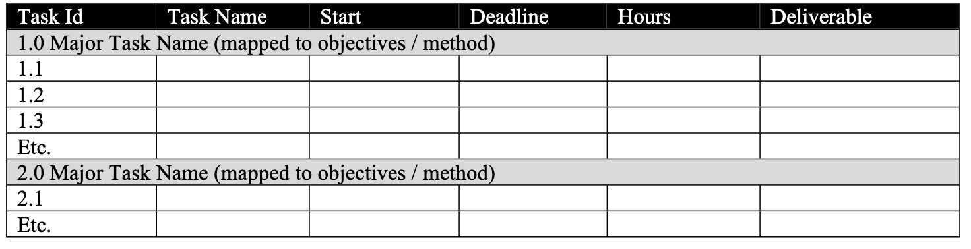
Section 2: Project Schedule – 20%
Section 2.1 Effort
Tables in the template need to be edited to include your information
What are the major / main tasks and how will you decompose them?
How much time do you anticipate spending on each sub-task?
When do you plan on starting and finishing the tasks?
What are the outcomes (deliverables) of task
Deliverables must be tangible and something you can evidence.

Slide 10
Section 2 : Project Schedule – 20%
Section 2.1 Effort
Remember to add the deliverables from Table 1: Effort into Table 2 : Deliverables
They must be the same set of deliverables in each table!
Use the major task names from Table 1 : Effort to create the first column in Table 4: Outline Schedule / Gantt Chart.
All of the tables in Section 2 should be consistent with major task names, deliverables and timelines

Slide 11
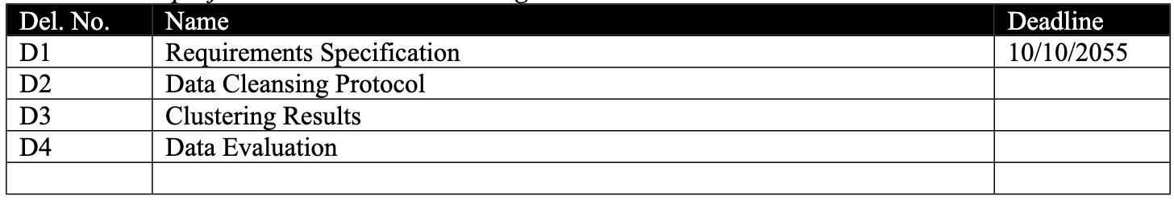
Section 2 : Project Schedule – 20%
Section 2.2: Deliverables
Deliverables are the outcomes of your research and practical work
For example:
Literature Review in Machine Learning
Review of algorithms to enable prediction in health datasets
Dataset selection and cleaning
Etc.
Often indicate the ending of tasks
Consistent nomenclature is important
Task 1 Deliverable 1 could be D1.1, etc
Should be added / consistent with the final column of Table 1:Effort
Consistent with Table 2.4 Outline Schedule

Slide 12
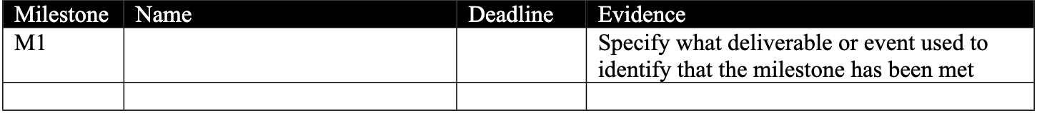
Section 2: Project Schedule – 20%
Section 2.3 Milestones
Indicators that there is progress
A way to identify when you have completed something
Add milestones in chronological order
Identify how you will know these have been achieved (evidence)
Consistent nomenclature and representation
Remember to include the milestones in Section 2.4 Outline Schedule

Slide 13
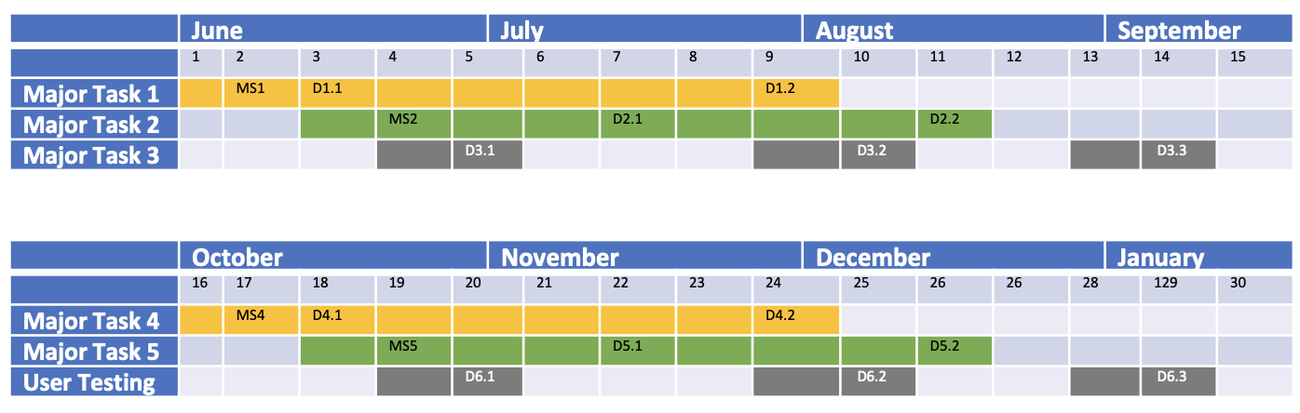
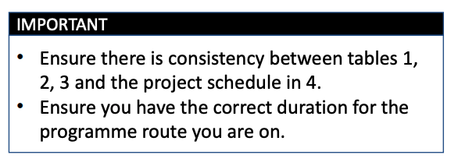
Section 2: Project Schedule – 20%
Section 2.4 Outline Schedule / Gantt Chart
Add the task names from Table 1 into Column 1.
Shade the rows to indicate task length.
Identify where you have milestones and deliverables and add them in.

Slide 14
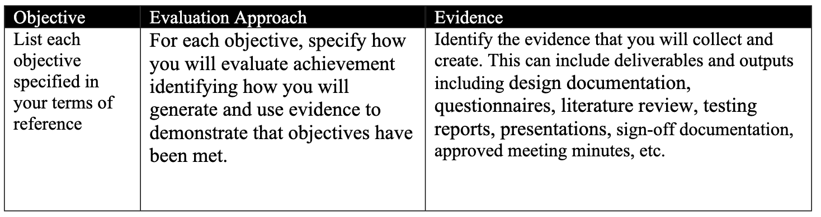
Section 3: Evaluation Plan – 10%
Evaluation Plan
Use the template provided – max 1 page.
Use your Objectives from Section 1.2 as the first column in the table
For each objective:
What was the ‘M’ in your SMART objective?
How will you know you have succeeded?
How do you demonstrate objectives reached?
What evidence will you provide?

Slide 15
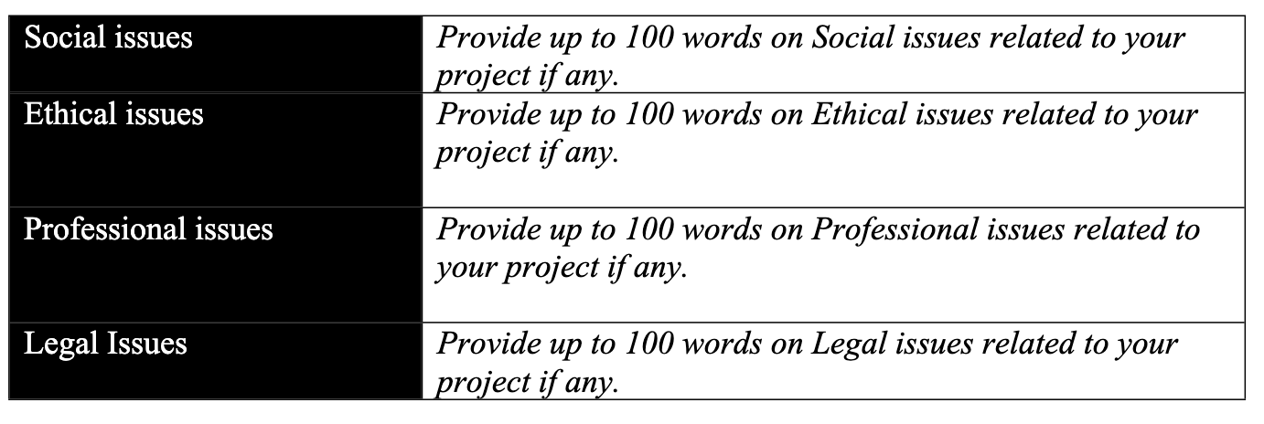
Section 4: Social, Ethical, Professional and Legal Issues – 20%
All projects have Social, Ethical, Professional and Legal Issues.
100 words max per section (4 sections)
Social Considerations:
Context of your project?
Sociotechnical concerns?
Data ethics
Ethical Considerations:
Recruiting participants?
Research methodology
Professional Considerations:
ACM Code of Conduct (https://www.acm.org/code-of-ethics)
Student / Supervisor relationship
Legal Considerations:
Legislation such as GDPR and Data Protection Act

Slide 16
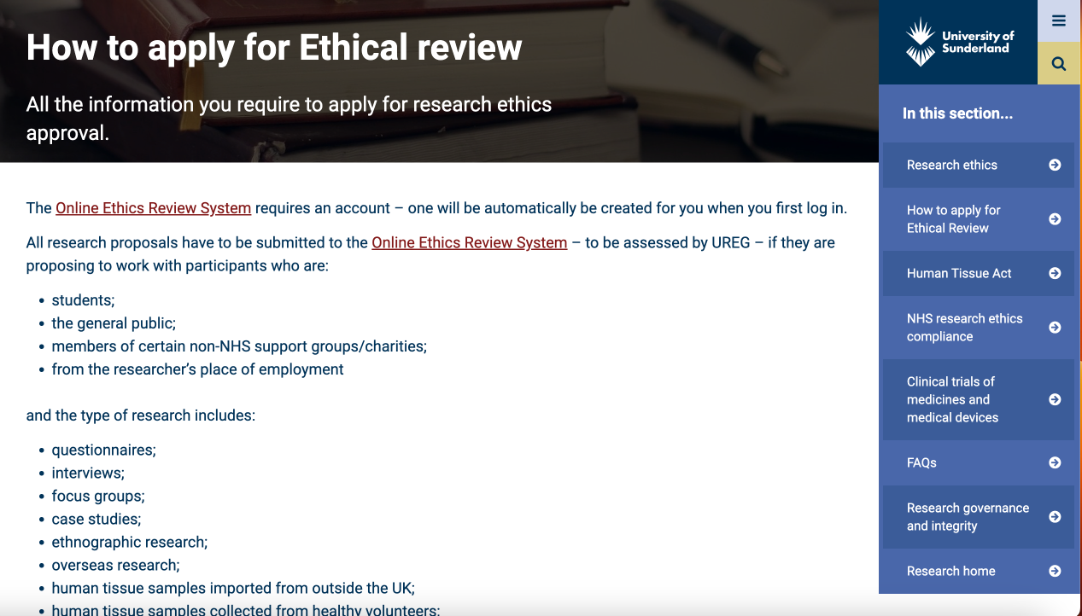
Ethical Approval Process
Ethics applications must go through the University Online Ethics Review System:
https://www.sunderland.ac.uk/more/research/research-governance-integrity/ethics/apply-ethical-review/
Further guidance on this process is available on Canvas → Units → Guidance Documents → Ethics Guidance

Slide 17

Summary
Detailed, prescriptive assignment
Follow the guidance and use the template provided
Ensure you complete every section
Ensure that you are consistent
In planning the project
In the objectives, deliverables, milestones and schedule
Remember to include appendices and references as appropriate
Harvard referencing style

Slide 18
Questions?

